Slide 1
IBM Content Navigator The Enterprise Content Management User Experience for the Future Session Number 1735
Stephen Hussey, IBM Product Management
Ian Story, IBM Product Management

Slide 2
Please note
IBM’s statements regarding its plans, directions, and intent are subject to change or withdrawal without notice at IBM’s sole discretion.
Information regarding potential future products is intended to outline our general product direction and it should not be relied on in making a purchasing decision.
The information mentioned regarding potential future products is not a commitment, promise, or legal obligation to deliver any material, code or functionality. Information about potential future products may not be incorporated into any contract. The development, release, and timing of any future features or functionality described for our products remains at our sole discretion.
Performance is based on measurements and projections using standard IBM benchmarks in a controlled environment. The actual throughput or performance that any user will experience will vary depending upon many factors, including considerations such as the amount of multiprogramming in the user’s job stream, the I/O configuration, the storage configuration, and the workload processed. Therefore, no assurance can be given that an individual user will achieve results similar to those stated here.
Notes:
IBM IOD 2011
10/23/2012
Prensenter name here.ppt
10/23/2012 12:50 PM
1

Slide 3
Acknowledgements and Disclaimers:
Availability. References in this presentation to IBM products, programs, or services do not imply that they will be available in all countries in which IBM operates.
The workshops, sessions and materials have been prepared by IBM or the session speakers and reflect their own views. They are provided for informational purposes only, and are neither intended to, nor shall have the effect of being, legal or other guidance or advice to any participant. While efforts were made to verify the completeness and accuracy of the information contained in this presentation, it is provided AS-IS without warranty of any kind, express or implied. IBM shall not be responsible for any damages arising out of the use of, or otherwise related to, this presentation or any other materials. Nothing contained in this presentation is intended to, nor shall have the effect of, creating any warranties or representations from IBM or its suppliers or licensors, or altering the terms and conditions of the applicable license agreement governing the use of IBM software.
All customer examples described are presented as illustrations of how those customers have used IBM products and the results they may have achieved. Actual environmental costs and performance characteristics may vary by customer. Nothing contained in these materials is intended to, nor shall have the effect of, stating or implying that any activities undertaken by you will result in any specific sales, revenue growth or other results.
© Copyright IBM Corporation 2012. All rights reserved.
U.S. Government Users Restricted Rights - Use, duplication or disclosure restricted by GSA ADP Schedule Contract with IBM Corp.
IBM, the IBM logo, ibm.com, FileNet, and IBM Connections are trademarks or registered trademarks of International Business Machines Corporation in the United States, other countries, or both. If these and other IBM trademarked terms are marked on their first occurrence in this information with a trademark symbol (® or ™), these symbols indicate U.S. registered or common law trademarks owned by IBM at the time this information was published. Such trademarks may also be registered or common law trademarks in other countries. A current list of IBM trademarks is available on the Web at “Copyright and trademark information” at www.ibm.com/legal/copytrade.shtml
Other company, product, or service names may be trademarks or service marks of others.
Microsoft SharePoint
Notes:
IBM IOD 2011
10/23/2012
Prensenter name here.ppt
10/23/2012 12:50 PM
2

Slide 4
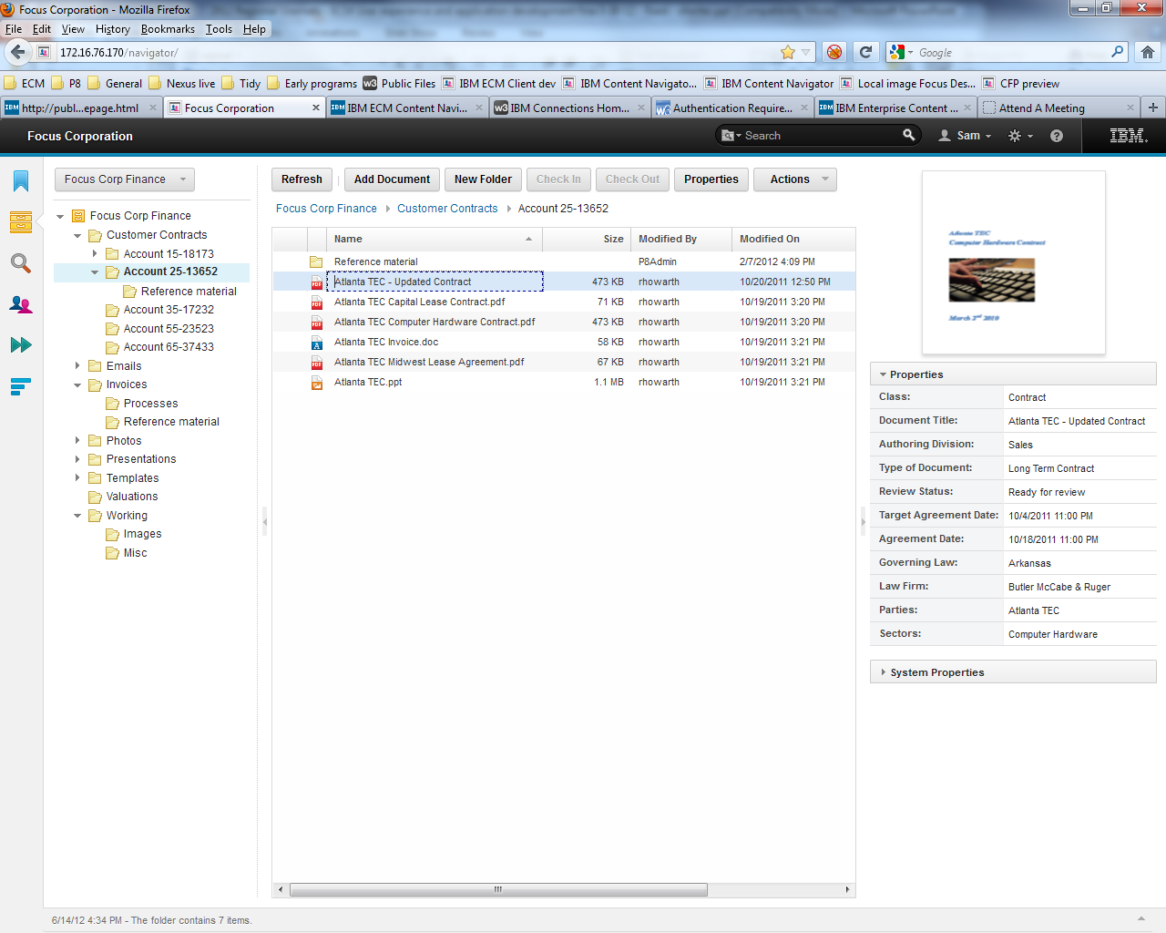
IBM Content Navigator

Slide 5
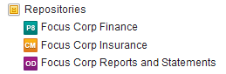
IBM Content Navigator - ECM User Experience
IBM Content Navigator is a collaborative and mobile content experience
Access to documents anywhere
FileNet Content Manager
IBM Content Manager
Content Manager OnDemand
CMIS (tech preview)
ICA text search
Desktop and mobile
Browser application
iOS mobile application
Benefits
Business user access to all documents
Common navigation and terminology regardless of source and workstation environment

Slide 6
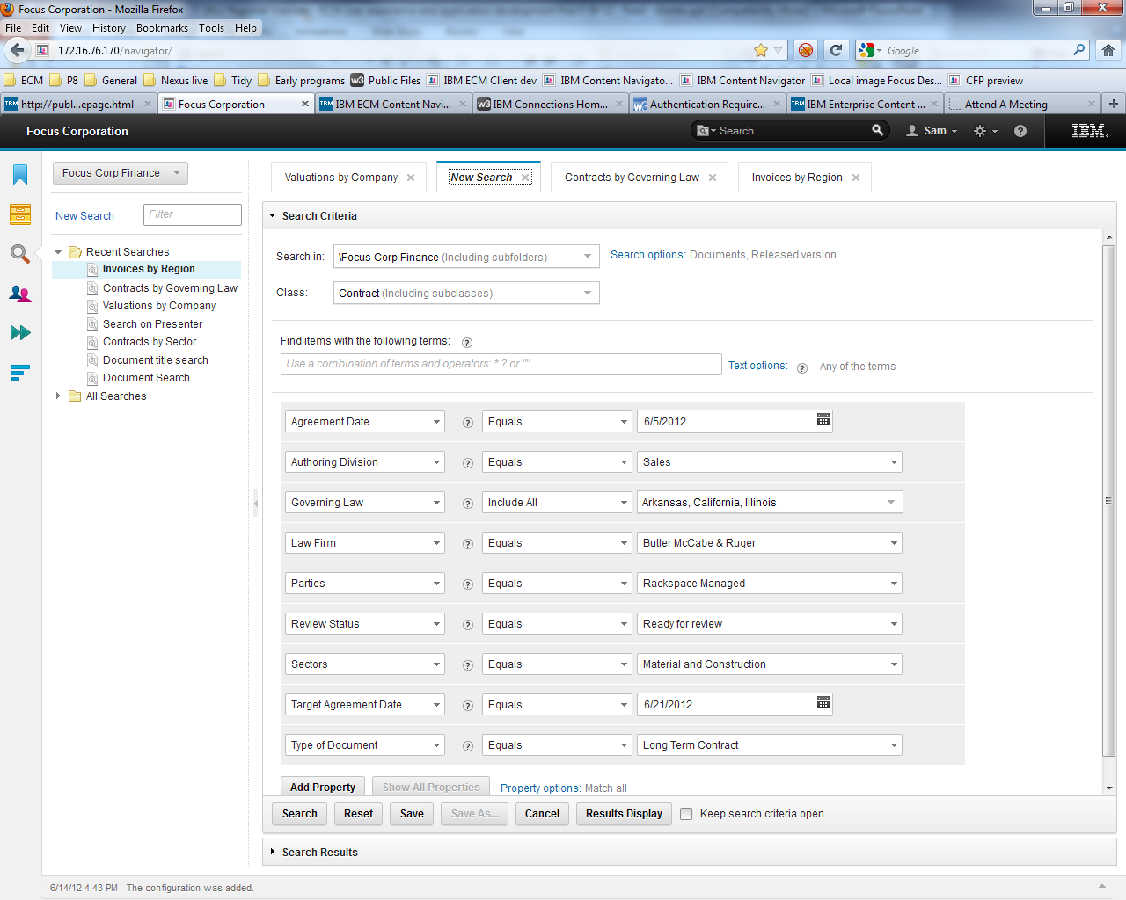
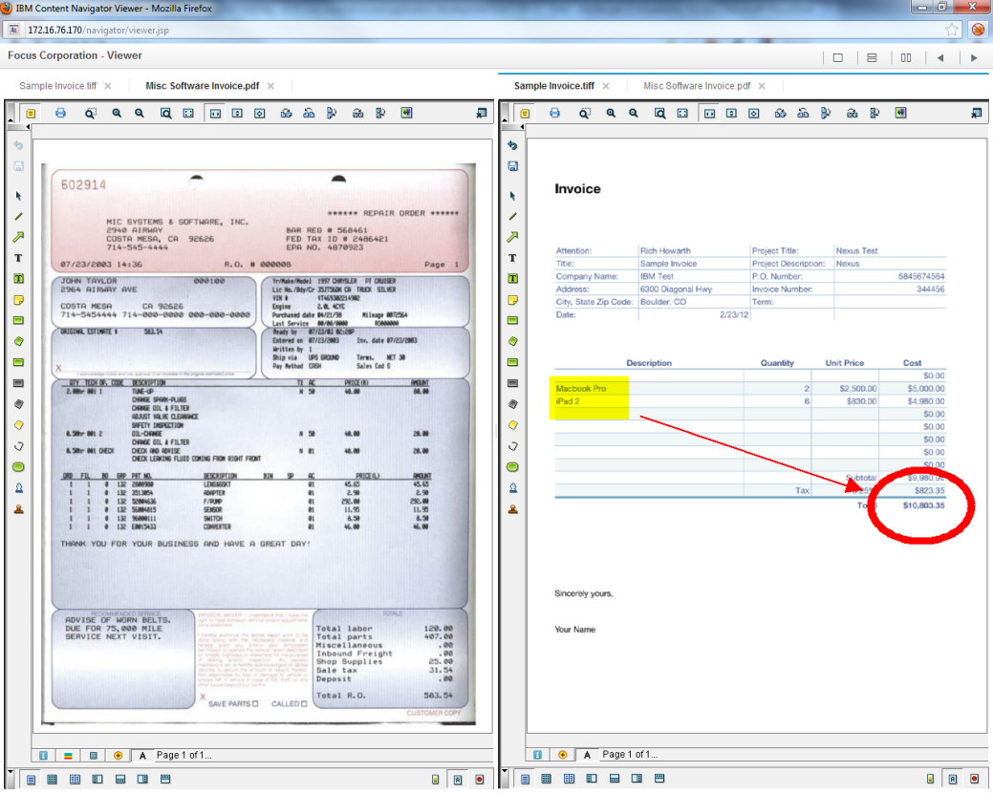
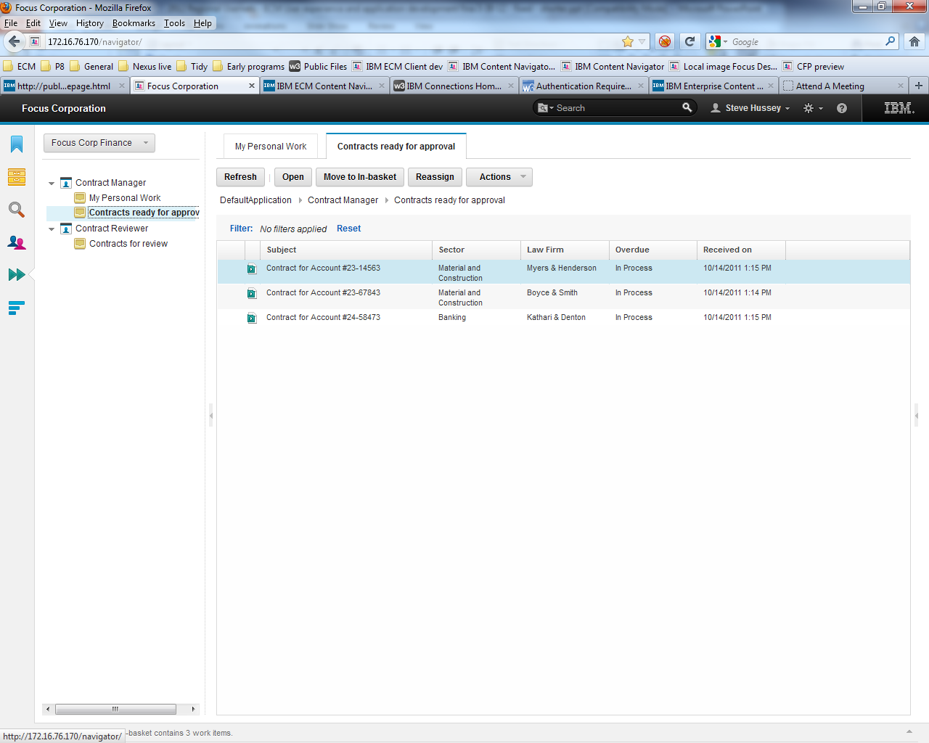
Production Imaging, reports and statements
Advanced search
Business processes
Work assignment
Image and statement viewing
Side by side and tabbed viewing
Annotations
Multiple Searches
Work delivery
Tabbed and side by side viewing

Slide 7
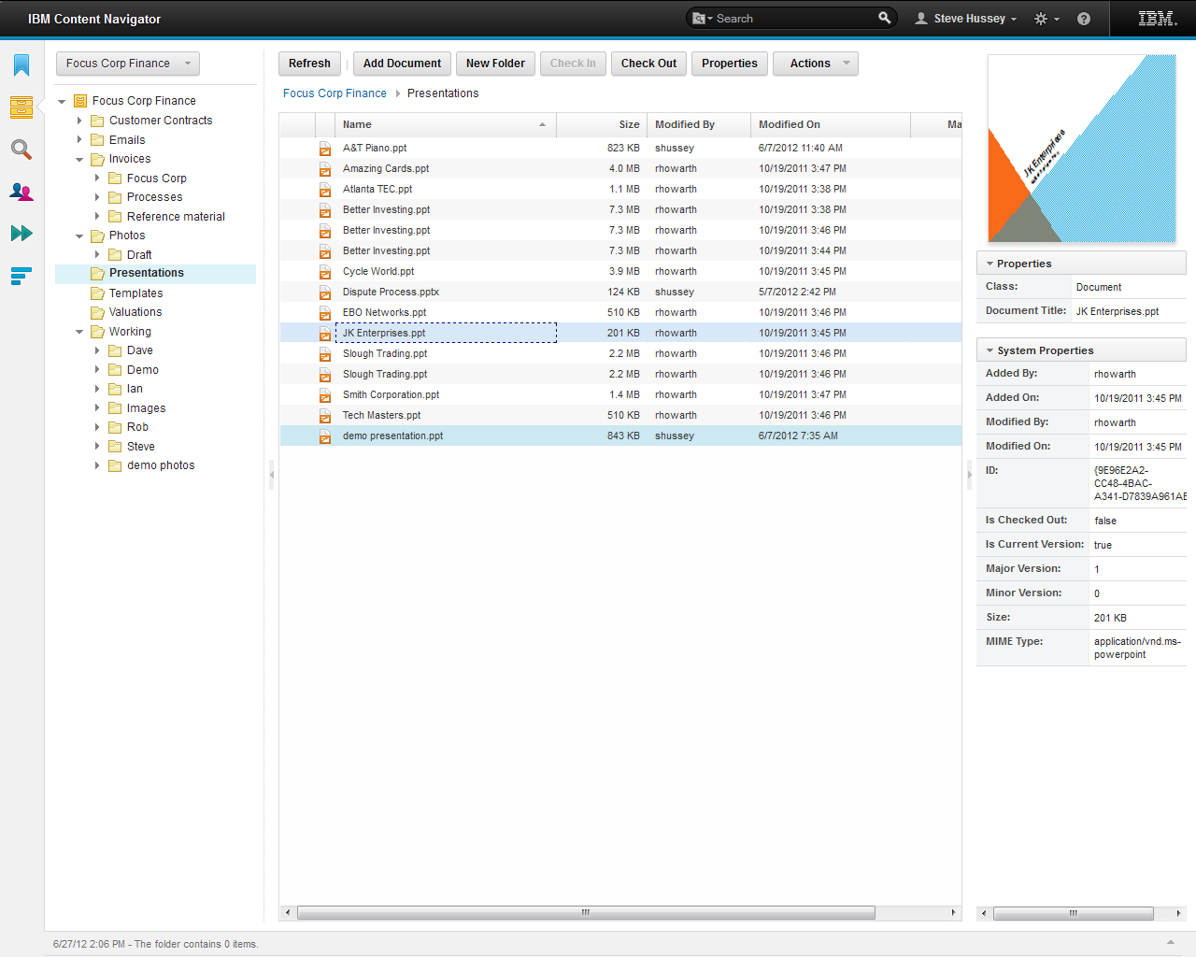
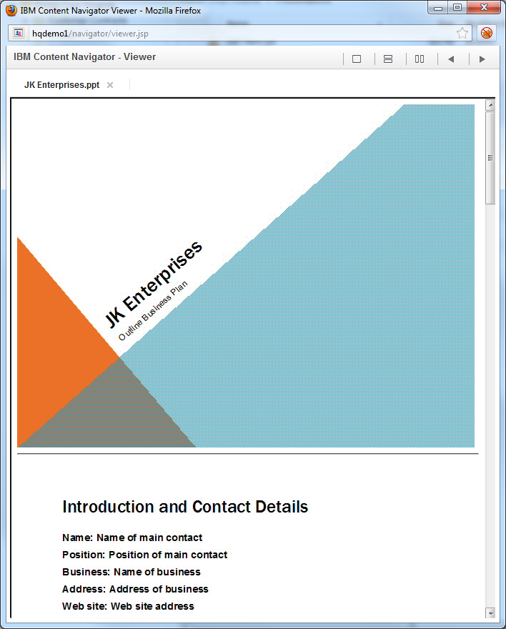
Collaborative content management
Thumbnails
Document authoring
Folder organization
Property and text search
Checkin/out
Classification and taxonomy
Flexible security
Review/approve
External Data integration
Thumbnail and preview
Office Document Preview

Slide 8

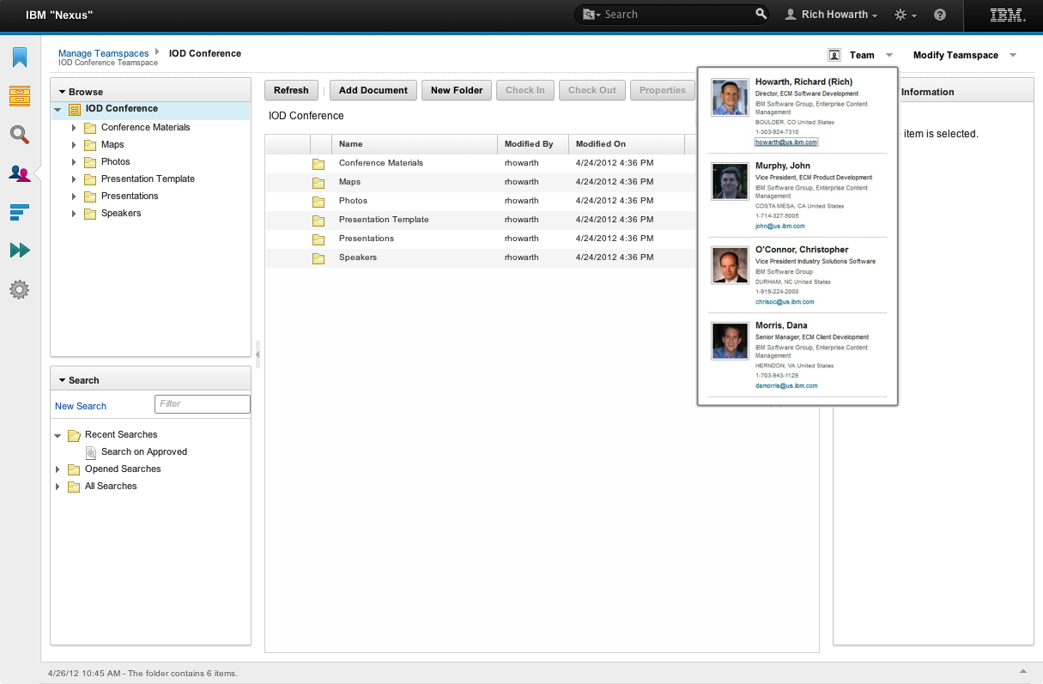





Business self provisioning
My Documents replacement
Quarterly and annual business reviews
Events and conferences
Standard operating procedures
Contracts/ vendor management
…
Teamspace

Slide 9
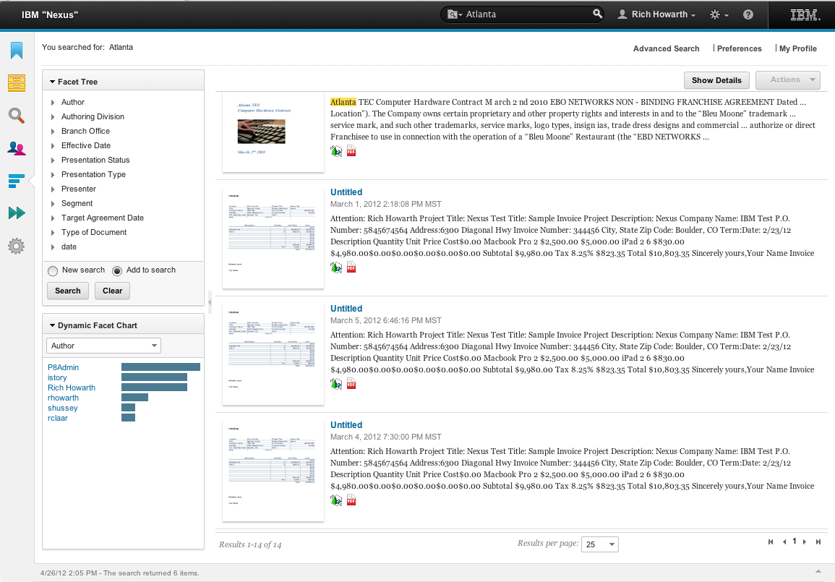
Navigator ICA Enterprise Search
Enterprise search integration using IBM Content Analytics (ICA)
Built as a ICN plug-in
Type-ahead
Synonyms
Term/”hit” highlighting
Thumbnails
Navigation/facet search
Cross-repository search
Search documents, multiple repositories and other sources
Repository document actions (check-out, send-to, favorite, …)
Limited use license of ICA included allowing search collections for P8 and CM8
Full capability supported if ICA license purchased
Note: ICA search collection scalability guidelines must be observed when building collections for large ECM repositories. These are available in the ICA community

Slide 10


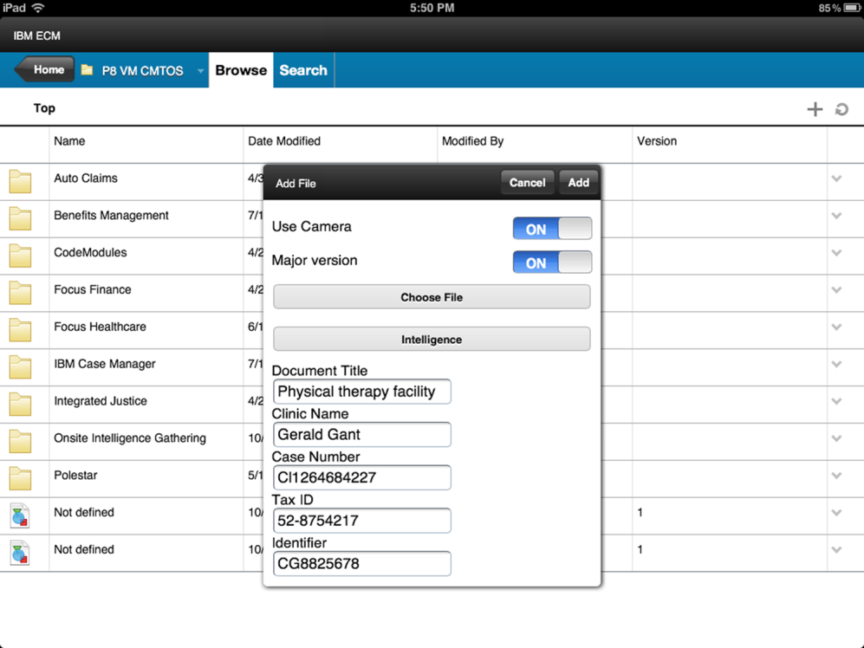
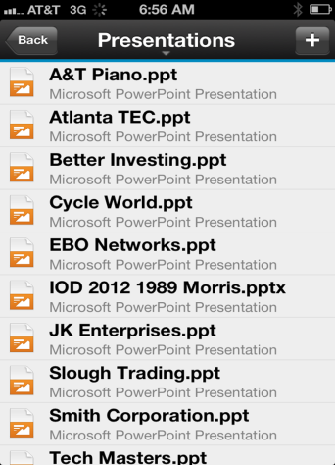

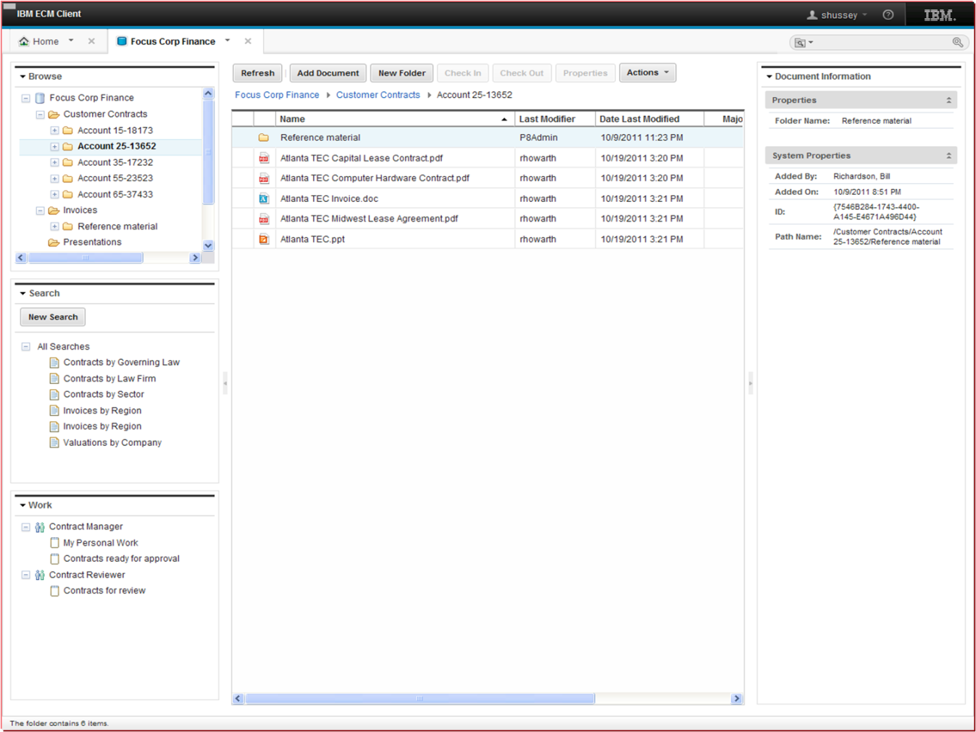
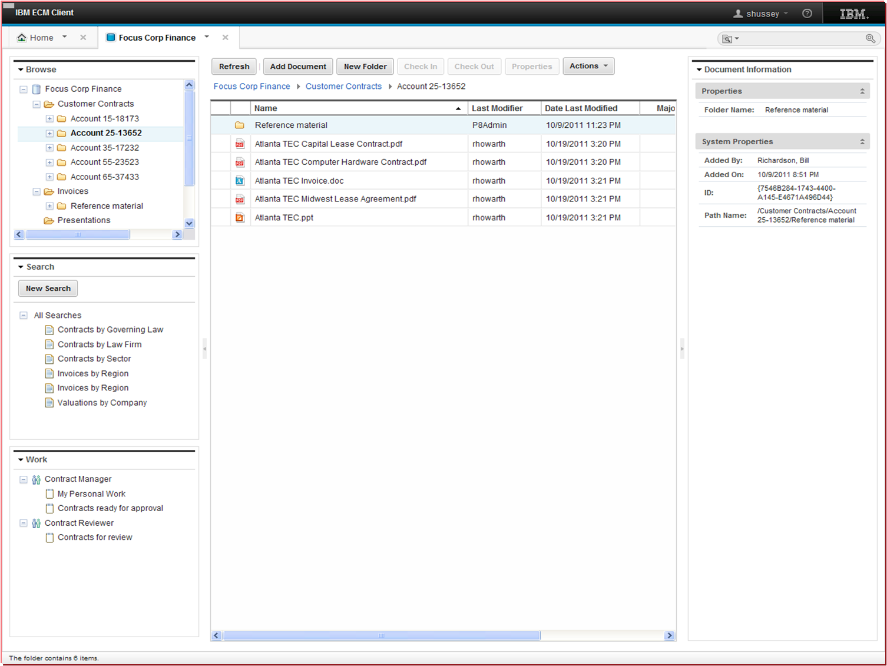

Mobile solutions matching business needs
Horizontal and vertical Partner solutions
IBM Content Navigator for iOS
Browse
Search
View
Add using camera
…
9
Notes:
Here’s a screen capture from the iOS interface, illustrating Content Navigator’s capabilities to:
Browse the folder structure
Searching the repository
Adding documents into the repository from the device, including the on-board camera.
Note: regarding the metadata entered here from the mobile app…. choice lists will work from here.
9

Slide 11
Mobile demonstration

Slide 12
Upcoming 2.0.1 release
Target is late Q4
Date is subject to change
Web
Production CMIS support (Documentum, SharePoint 2013, others…)
Multi-document actions, API improvements, teamspace enhancements, etc.
Mobile
iPhone & iPod Touch support
Basic offline support
Check out, check in, property editing, etc.
Office
No longer requires Workplace / XT
P8 full support, CM8 as tech preview
External Data Services, property mapping from Office docs, Teamspaces, etc.

Slide 13
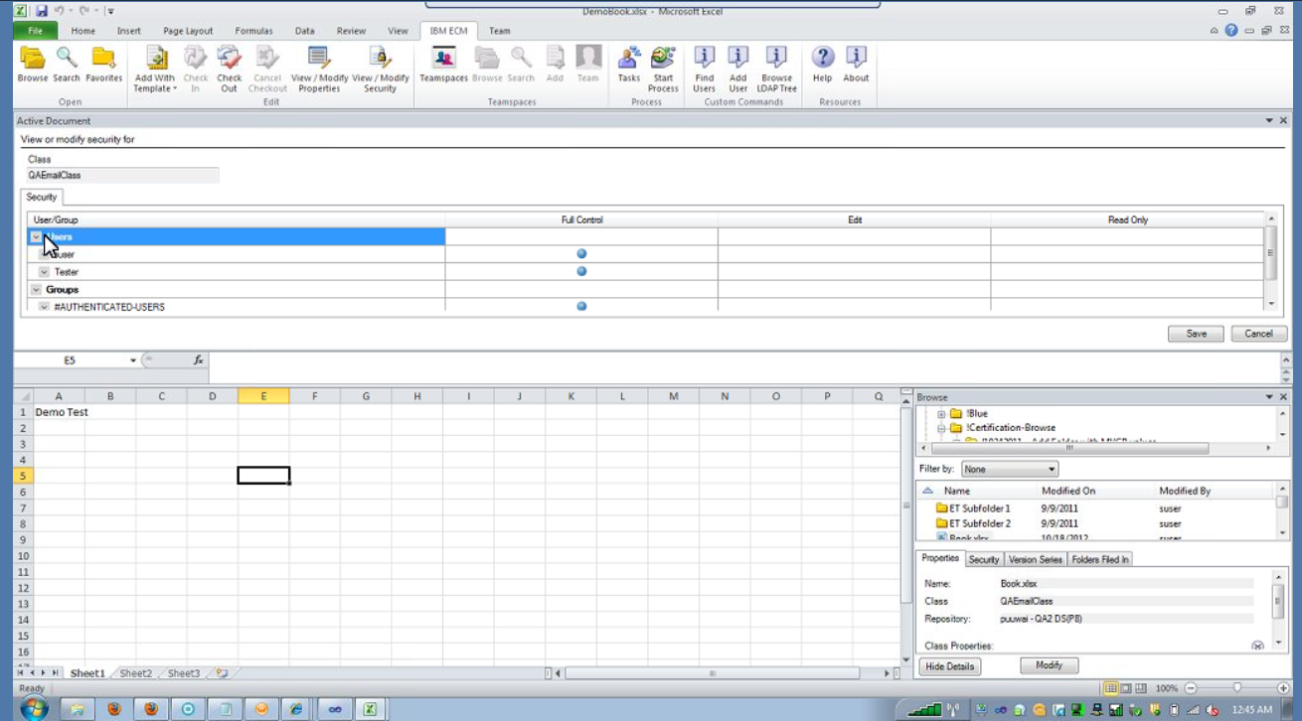
IBM Content Navigator for Office
Consistent experience for Navigator web and office integration
Common searches, favorites, teamspaces
Centralized admin
Data interaction
External Data Services support
Microsoft Office properties to class property mapping
CM8 repository support technical preview

Slide 14
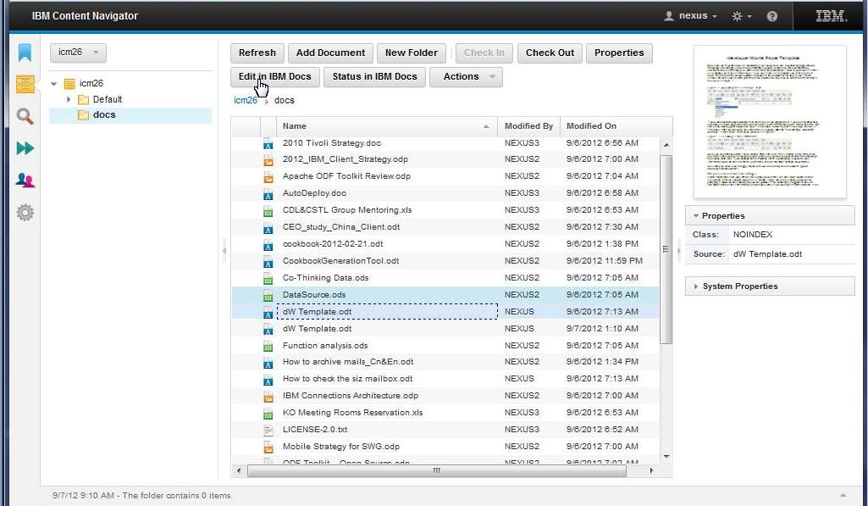
IBM Docs prototype integration (1 of 2)

Slide 15
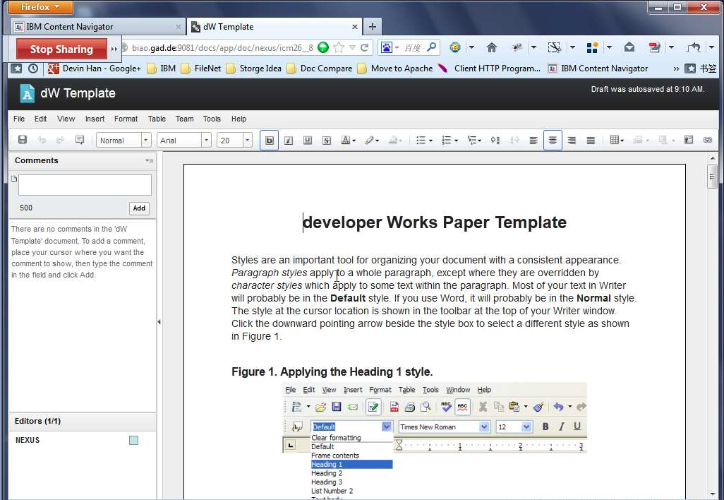
IBM Docs prototype integration (2 of 2)

Slide 16
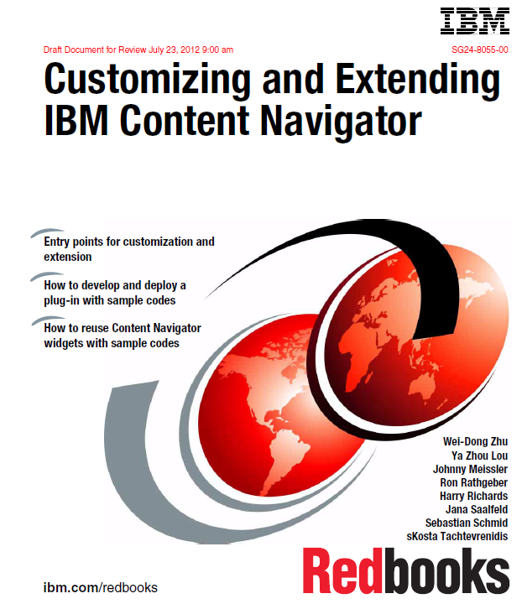
IBM Content Navigator
Developer Redbook
Setting up a development environment
Building menus, plugins, layouts, external data services, …
Integrating into other environments
Available for download ibm.com/redbooks
Book signing at IOD

Slide 17
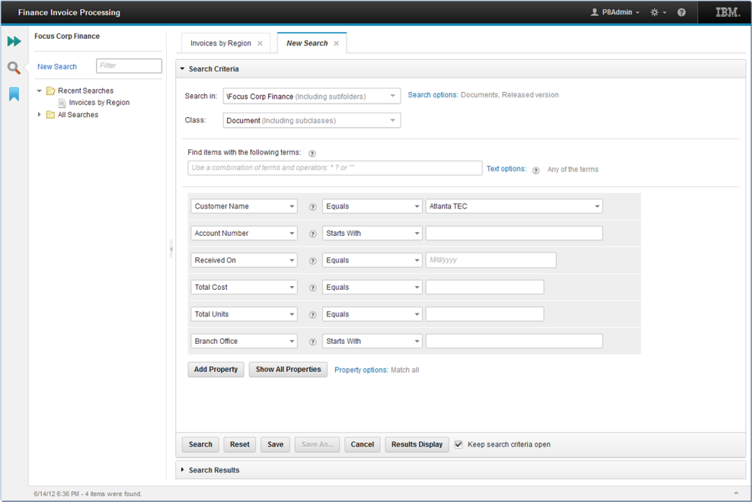
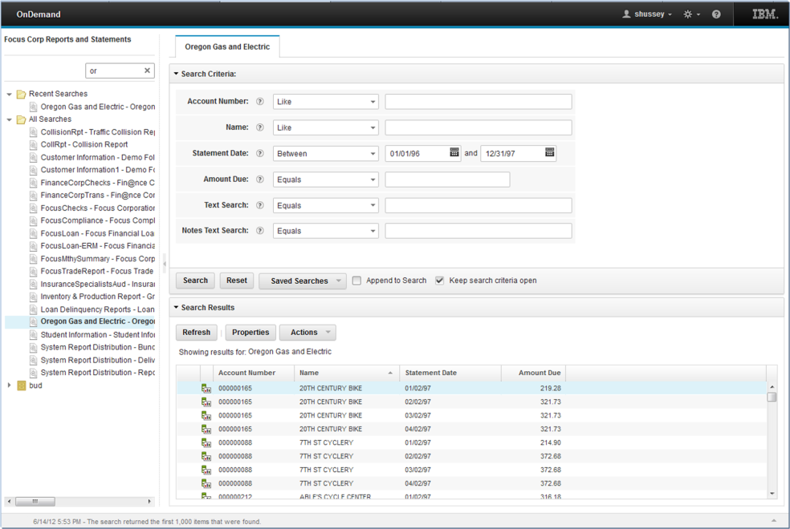
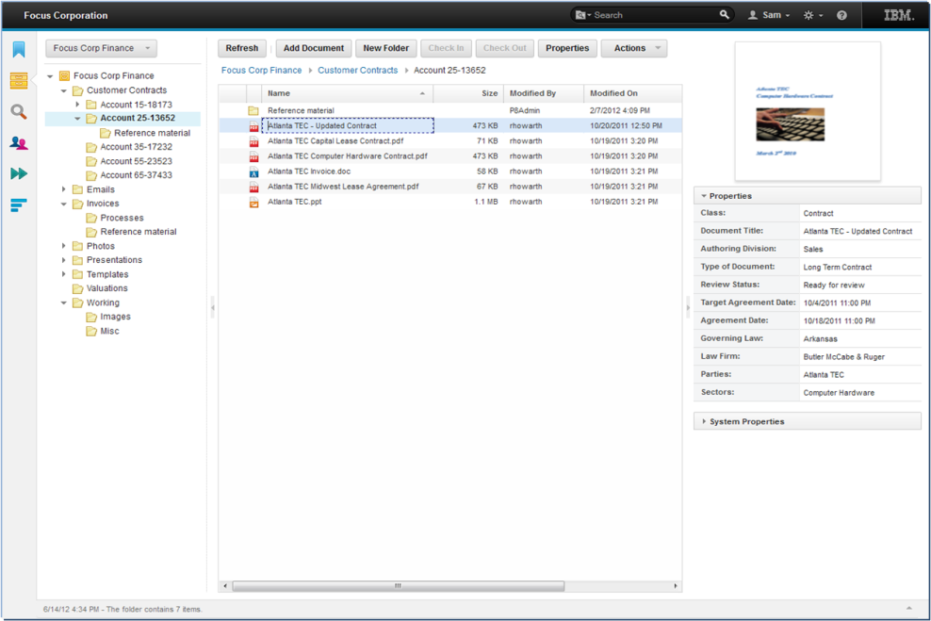
Navigator “Desktops” are applications
Invoice processing
Reports and Statements
Collaborative Authoring

Slide 18
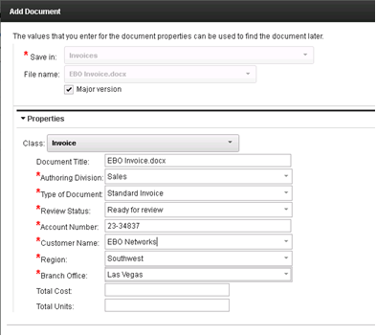
External data services
OOTB UI functionality
Applies to add document, checkin, modify properties, search
External choice lists
Dependencies between properties
Set default or dynamic values
Property value and format validation
Dynamic properties
External services are provided with user id, current action, browser language
Enables context sensitive data
Database
CRM
ERP
Custom
Notes:
External choice lists
Locations, Part numbers, Approvers, …
Dependencies between properties
E.g. Country, City, State
Set default or dynamic values
Property value and format validation
External or regular expressions
Dynamic properties
Hide/show & read-only/write

Slide 19
Navigator visual component toolkit ECM Dojo components
Change or extend Content Navigator
Build complete applications
ECM-enable applications in any framework
Use ECM Dijits, full Dojo library, other JavaScript packages to build your solutions
http://dojotoolkit.org/

Slide 20
Navigator toolkit with other frameworks
Dojo Dijits integrate into any web user experience
Interact with the rest of the desktop via JavaScript
Websphere Portal development tools support Dojo
http://www-10.lotus.com/ldd/portalwiki.nsf/dx/Dojo_and_WebSphere_Portal_wp8
Below is an example of SharePoint with Navigator embedded
Sample from the Navigator Redbook

Slide 21
IBM Content Navigator External information resources
Information centers:
IBM Content Manager with IBM Content Navigator:
http://publib.boulder.ibm.com/infocenter/cmgmt/v8r4m0/index.jsp
IBM Content Manager OnDemand with IBM Content Navigator:
http://publib.boulder.ibm.com/infocenter/cmod/v8r5m0/index.jsp
IBM FileNet Content Manager with IBM Content Navigator:
http://publib.boulder.ibm.com/infocenter/p8docs/v5r1m0/index.jsp
System requirements:
http://www.ibm.com/support/docview.wss?uid=swg27024958
Publication library:
http://www.ibm.com/support/docview.wss?uid=swg27025015
Navigator public forum
http://www.ibm.com/developerworks/forums/forum.jspa?forumID=2869&cat=19
Navigator mobile public forum
http://www.ibm.com/developerworks/forums/forum.jspa?forumID=2868&cat=19
Note: Customers and partners download Navigator as a component of the latest repository server release (P8 5.1, CM8.4.3, CMOD 8.5)

Slide 22
IBM Content Navigator Web Based Training Education Course
Cost
Customers would purchase this training
Offering summary
This course is available for IBM employees, SVP Business Partners, and Customers who are responsible for making decisions about deploying Content Navigator and would like to know more about how to configure the software.
What you will learn
IBM Content Navigator features and benefits
High-level architecture and design of IBM Content Navigator
Basic platform, browser, and other requirements for using IBM Content Navigator
How to perform business user tasks for working with IBM FileNet P8, IBM Content Manager, and IBM Content Manager OnDemand content
How to perform IBM Content Navigator administrative configuration tasks
Where to find the Content Navigator course F205
The ECM course catalog: http://www-01.ibm.com/software/ecm/training/
(Click on link to access the catalog and then search for the course number F205)
The Learner Portal: http://eb90.elearn.ihost.com/wps/portal/ibm

Slide 23
Communities
On-line communities, User Groups, Technical Forums, Blogs, Social networks, and more
Find the community that interests you …
Information Management bit.ly/InfoMgmtCommunity
Business Analytics bit.ly/AnalyticsCommunity
Enterprise Content Management bit.ly/ECMCommunity
IBM Champions
Recognizing individuals who have made the most outstanding contributions to Information Management, Business Analytics, and Enterprise Content Management communities
ibm.com/champion

Slide 24
Thank You! Your Feedback is Important!
Access SmartSite to complete your session surveys
Any web or mobile browser at iodsmartsite.com
Any SmartSite kiosk onsite
Each completed session survey increases your chance to win an Apple TV with daily drawing sponsored by Alliance Tech
Notes:
23

